Slide 1
Reproducibility Project: Predictive Multi-level Patient Representations from Electronic Health Records
shaukat2@illinois.edu

Slide 2
General Problem Statement
Traditional sequence models do not work efficiently to cater these short-term and long-term dependencies.

Slide 3
General Problem Statement
This paper proposes a technique which is able to solve this issue by first dealing with short-term co-occurrences modelled by sparse attention mechanism, then it uses event pooling based on time-interval to remove unnecessary information to shorten sequence length. This sequence is fed to LSTM for prediction task.

Slide 4
General Problem Statement
This model is called Multi-Level Representation Model (MRM) that improves performance of clinical outcome prediction as compared to traditional statistical models like SVM, Logistic Regression (LR) and sequential neural network models like RETAIN, TCN, LSTM, Timeline etc.

Slide 5
Approach : Short-term Co-occurrence Modeling:
MRM is a muti-level representation model, which first defines attention mechanism on indexed set of events. This attention mechanism is multiheaded to identify neighbourhood representation of events.

Slide 6
Event Group Pooling
Based on neighborhood representation, non overlapping groups are identified which are then passed through max-pooling layer. These groups are identified if they satisfy two conditions: 1) Event group interval should be small; 2) Number of event groups should not be large.

Slide 7
LSTM
These event groups are then passed to LSTM using cross entropy function to calculate loss.

Slide 8
Challenges
No data set available
No code available

Slide 9
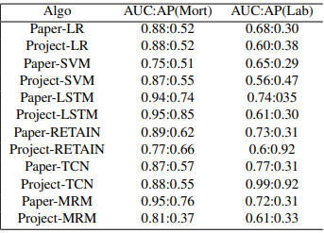
Results

